Slide 1
Operating System
Chapter 1-2: Basic Concept and Prerequisite knowledge
宫晓利
Department of Computer Science, NanKai University
Email: gongxiaoli@nankai.edu.cn

Slide 2
Computer Hardware Review
Processors: Architecture and Modes
Memory: Hierarchy of storage systems
I/O Devices: Clock, keyboard, monitor and hard disk
Buses: Organization of computer system

Slide 3
History of Processors
The beginning of microprocessor
1960s, Intel 4004 & Intel 440
4bits, 4K address space, 45 instructions, 50KIPS
The beginning of modern microprocessor
1971, Intel 8008: 8bits, 16K address space, 48 instructions, 50KIPS
1973, Intel 8080 & 8085: 64K address space, ,246 instructions, 500KIPS
1973, Motorola MC6800; Zilog Z80; MOS 6502
16 bit microprocessor
1978, Intel 8086; 1979, Intel 8088; 1983, Intel 80286
16bits, 1MB address space, 20K instructions, 2.5MIPS & 4.0MIPS
Motorola MC68000
32 bit & 64 bit microprocessor
Intel 80386(1986), Intel 80486(1989), Intel Pentium(1993)
32bits, 4GB address space, CISC & RISC, xGIPS
64bits, 64PB address space,

Slide 4
Guide line of processor’s capability
Frequency
CPU clock speed = CPU socket speed * clock multiplier
CPU socket speed: the times per second that transfer data from/to CPU, generated by mainboard
Front side bus speed: the bandwidth that transfer data between “Northbridge” chip and CPU
Clock multiplier
Memory clock speed
Instruction set & Coprocessor
CISC, RISC
Float processor, Boolean processor
Cache
Level1& Level 2 cache: registers & buffers
Architecture
Micro-architecture, Superscalar & super-pipeline
Technics
45nm→32nm→22nm→14nm→5nm

Slide 5
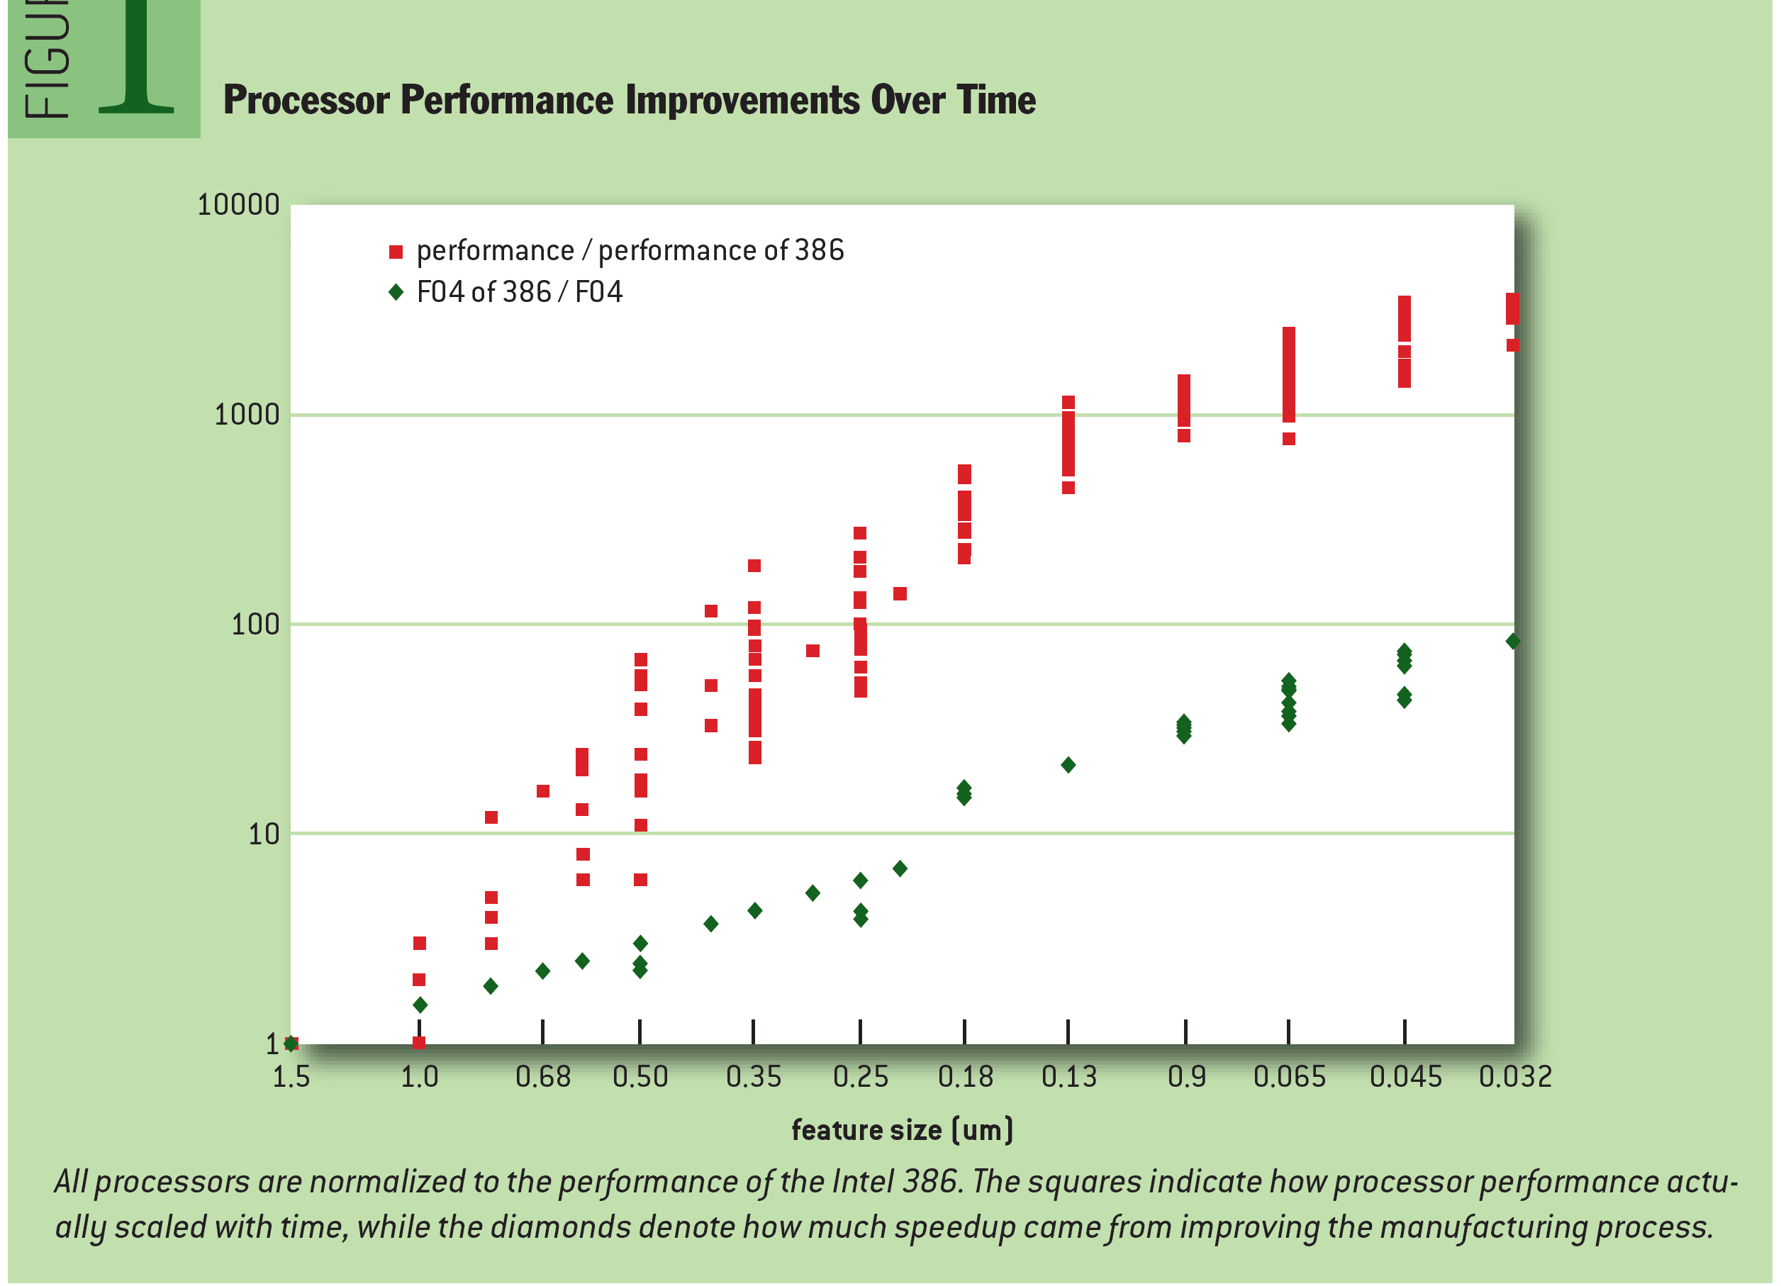
How CPU evolves
CPU DB: Recording Microprocessor History, Danowitz et al. Communications of the ACM, Vol. 55 No. 4, 2012.

Slide 6
Structure of microprocessor
Execute unit
Execute the specified instruction
Control unit
Fetch instruction from memory to registers
Maintain the status of CPU
Data transfer between CPU and memory
Register and Cache
Pipeline && Parallize

Slide 7
Instruction cycle of processor
Fetch instruction from memory
Program Counter stores the address of next instruction
Processor fetch the instruction via memory access
Decode instruction
Store the parameters of the instruction into registers
Execute instruction
Instruction Register stores current instructions
Integer, float and Boolean processors
Pipeline
Sequence of circuit units to execute an instruction
Start
Fetch unit
Decode unit
Execute unit
End

Slide 8
Registers in CPU
Address register
Store the address of data or instruction
Data register
Store the operand/operator of instruction
Flag register
Store the flags of operation
Control and status register
Used by OS for managing CPU
Operating System
8
CITS, NanKai University

Slide 9
Registers in CPU (privileged)
Program counter
The register that stores address of next instruction
Each process has its private PC value
Instruction register
Stores the instruction to be executed
Each process has its private IC value
Program status word
The register that stores flags and conditions of CPU working status
PSW is the most important part of CPU context
Operating System
9
CITS, NanKai University

Slide 10
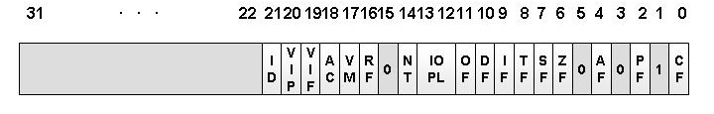
PSW of Intel CPU
标准条件位：
TF：陷阱标志位
IF：中断允许（中断屏蔽）标志位
VIF：虚拟中断标志位
VIP：虚拟中断待决标志位
IOPL：IO特权级别
CF： 进位标志位
ZF： 结果为零标志位
SF： 符号标志位
OF： 溢出标志位
Operating System
10
CITS, NanKai University

Slide 11
PSW的使用示例
Load AX 0xfffffff1
ADD AX 0x5F
Load AX 0x0
ADD AX 0x50
这两段指令执行之后，AX寄存器的值一样吗？
他们发生的事情一样吗？
如何知道这些差异？
Operating System
11
CITS, NanKai University

Slide 12
Essential of CPU
Rank of CPU instruction
R0: privileged instruction only used by OS
R1: important device driver and I/O routine
R2: protected program, such as IDE
R3: user space for common program
Working mode of CPU
Kernel mode & User mode
“Trap”
Switch the mode of CPU from “user” mode to “kernel” mode
Operating System
12
CITS, NanKai University

Slide 13
Computer Hardware Review
Processors: Architecture and Modes
Memory: Hierarchy of storage systems
I/O Devices: Clock, keyboard, monitor and hard disk
Buses: Organization of computer system
Operating System
13
CITS, NanKai University

Slide 14
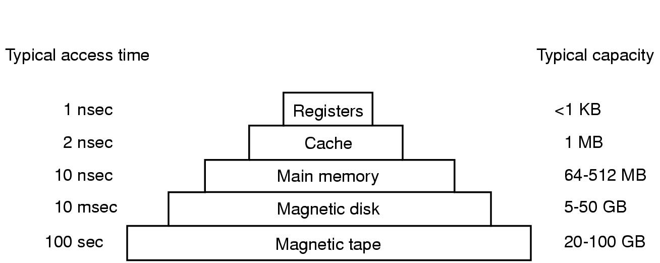
Storage system in computer
Operating System
14
CITS, NanKai University

Slide 15
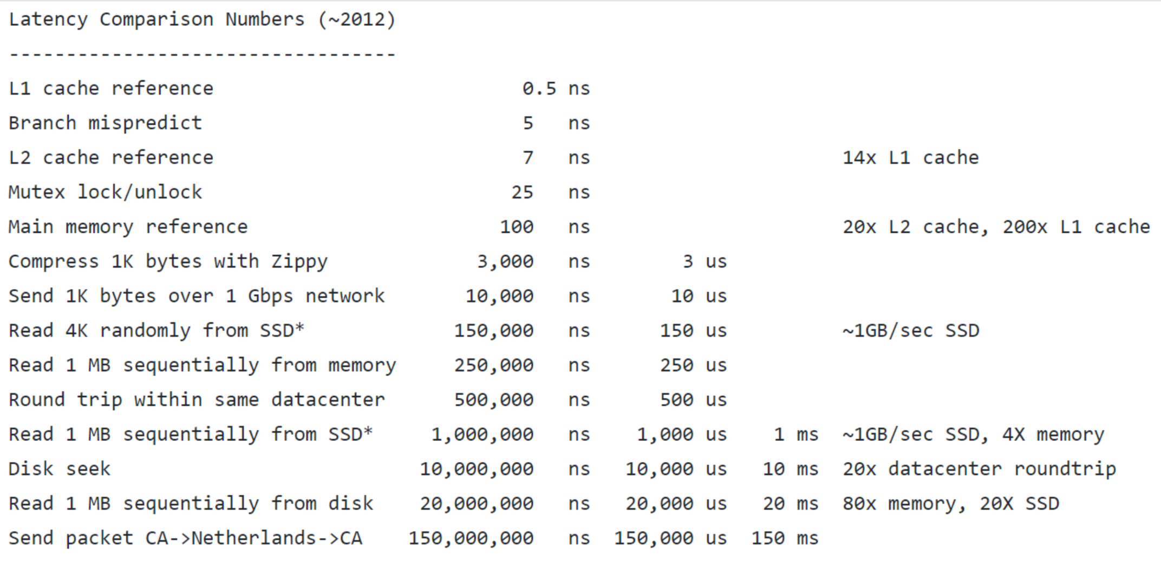
一些非常重要的数字
By Jeff Dean: http://research.google.com/people/jeff/

Slide 16
Strategy of storage system
Guide lines for storage system
Speed: should be not slower than CPU speed
Size: should be enough large that can store everything
Cost: should not be expensive for most customers
Strategy for a reasonable storage system
Local optimal principle
Hierarchy architecture
Various kinds of memory
Register, RAM, SRAM, DRAM, SDRAM, DDR
ROM, PROM, EPROM, EEPROM, CMOS
Flash memory
Operating System
16
CITS, NanKai University

Slide 17

Local optimal principle
A story about Yangguo and Xiaolongnv
The answer exists around the question
Local optimal principle in address space
The address of next instruction should be adjacent to current instruction
Local optimal principle in time sequence
The instruction used recently should be used again in the near future
Principle of Cache design
Only stores the instructions that belong to a local region, both in address space and time sequence
Small size, but higher performance and cheap price
Operating System
17
CITS, NanKai University

Slide 18
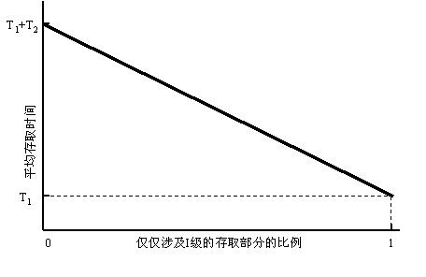
Local optimal principle
Operating System
18
CITS, NanKai University

Slide 19
Memory Management
在多道环境中存储管理要解决的主要问题是：
用户程序间如何保护
核心程序如何受到保护
执行程序如何重定位
19

Slide 20
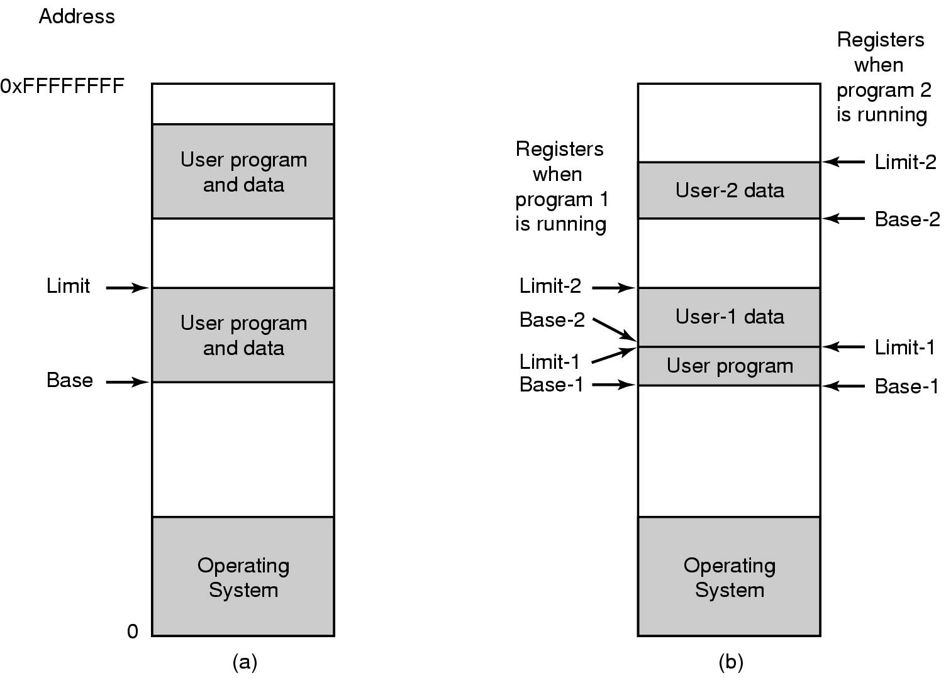
Memory Management
硬件提供基址和界限寄存器为内存管理提供基础：
One base-limit pair and two base-limit pairs
20

Slide 21
Computer Hardware Review
Processors: Architecture and Modes
Memory: Hierarchy of storage systems
I/O Devices: Clock, keyboard, monitor and hard disk
Buses: Organization of computer system
Operating System
21
CITS, NanKai University

Slide 22
Clock in computer
What dose time means in computer
The speed of operation and execution
The criterion of resource management
The bandwidth of data transfer
The record of real time
Components of programmable clock
Crystal oscillator: physical component
Counter: decremented at each pulse
Holding register: record the initial value of counter
One-shot clock and square-wave clock
One-shot clock: controlled by OS software
Square-wave clock: generate periodic signal
Clock tick: periodic interrupts
Operating System
22
CITS, NanKai University

Slide 23
Clock and clock interrupts
每个脉冲使计数器减1，归零则产生时钟中断
用来装入计数器初值
Operating System
23
CITS, NanKai University

Slide 24
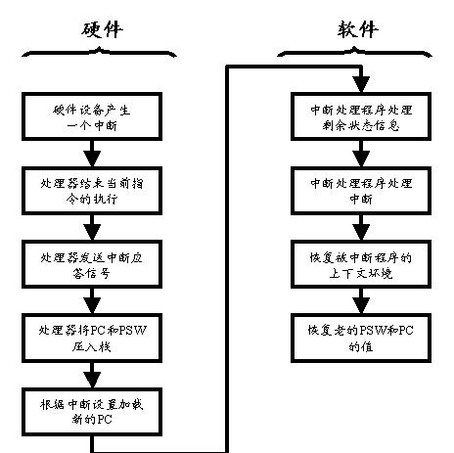
Essential of Interruption
Operating System
24
CITS, NanKai University

Slide 25
Essential of Interruption
取周期
执行周期
中断周期
不允许中断
取下一条指令
执行指令
检查指令
处理中断
开始
允许
中断
停止
Operating System
25
CITS, NanKai University

Slide 26
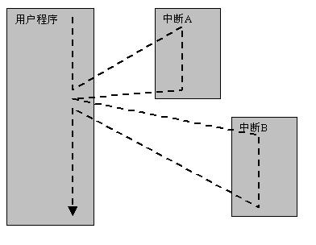
Essential of Interruption (unnested)
Operating System
26
CITS, NanKai University

Slide 27
Essential of Interruption (nested)
低优先级中断嵌套高优先级中断的处理流程
Operating System
27
CITS, NanKai University

Slide 28
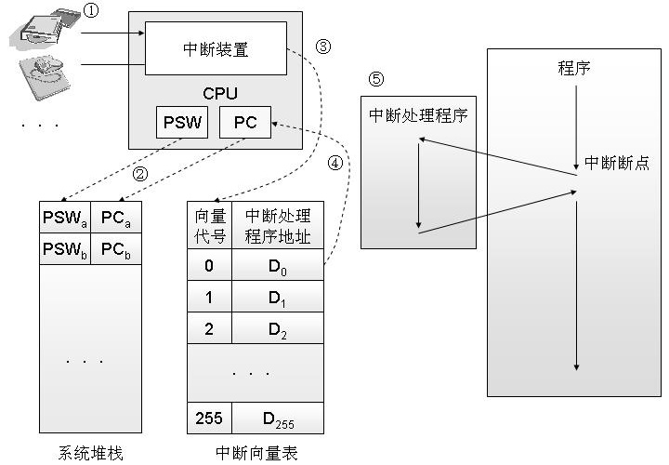
Essential of Interruption
Operating System
28
CITS, NanKai University

Slide 29
Interrupt, Exception and trap
Exception
Errors found by hardware, caused by program
Divide by 0, floating-point underflow, access denied
The exception will be handled by OS in kernel mode, or informed to the program and handled by user program
Interrupt
Signal sent from hardware to CPU
CPU finds and invokes interrupt handler (kernel mode)
In time-sharing OS, the interrupts are handled in clock interrupt function
System call
Interface provided by OS to allow programs obtaining some system service
“Trap” instruction will trap into kernel mode and invoked OS to execute service
Operating System
29
CITS, NanKai University

Slide 30
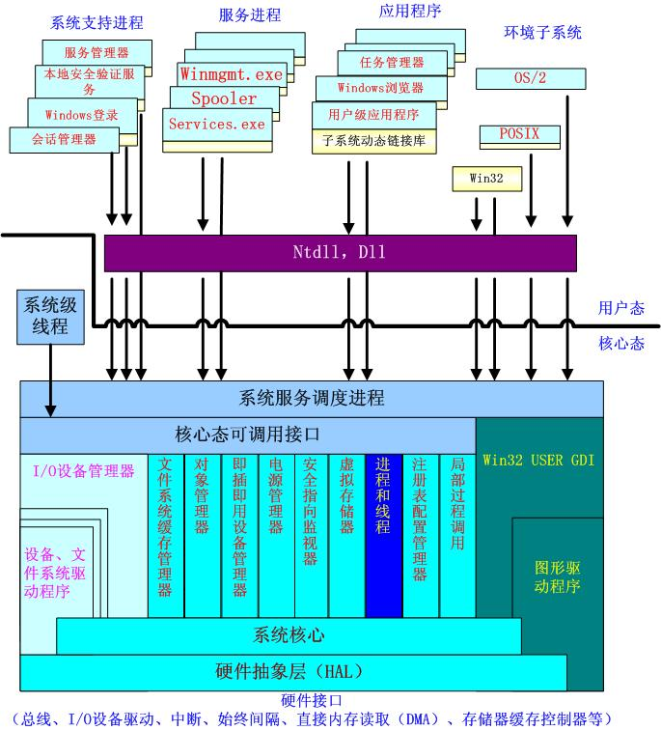
Operating System
30
CITS, NanKai University

Slide 31
I/O Device
I/O模块由一些设备控制器和相应的软件构成
处理器与I/O模块交互方式：
专用指令完成I/O访问
指令格式不变，对存储器访问换成I/O模块访问
I/O模块与存储器间交互 ：用 DMA（Direct Memory Access)模式
31

Slide 32
I/O Communication Techniques
1）程序控制I/O方式
由I/O软件控制I/O操作，包括设备状态检测、发送读写命令和传送数据等，无中断。
2）中断驱动I/O方式
处理器发传送命令后，转去做其他的工作，I/O准备好后打断处理器的工作，完成数据传递。
3）直接存取I/O方式
外设与内存直接存取，处理器只参与数据传递中的头尾过程。
32

Slide 33
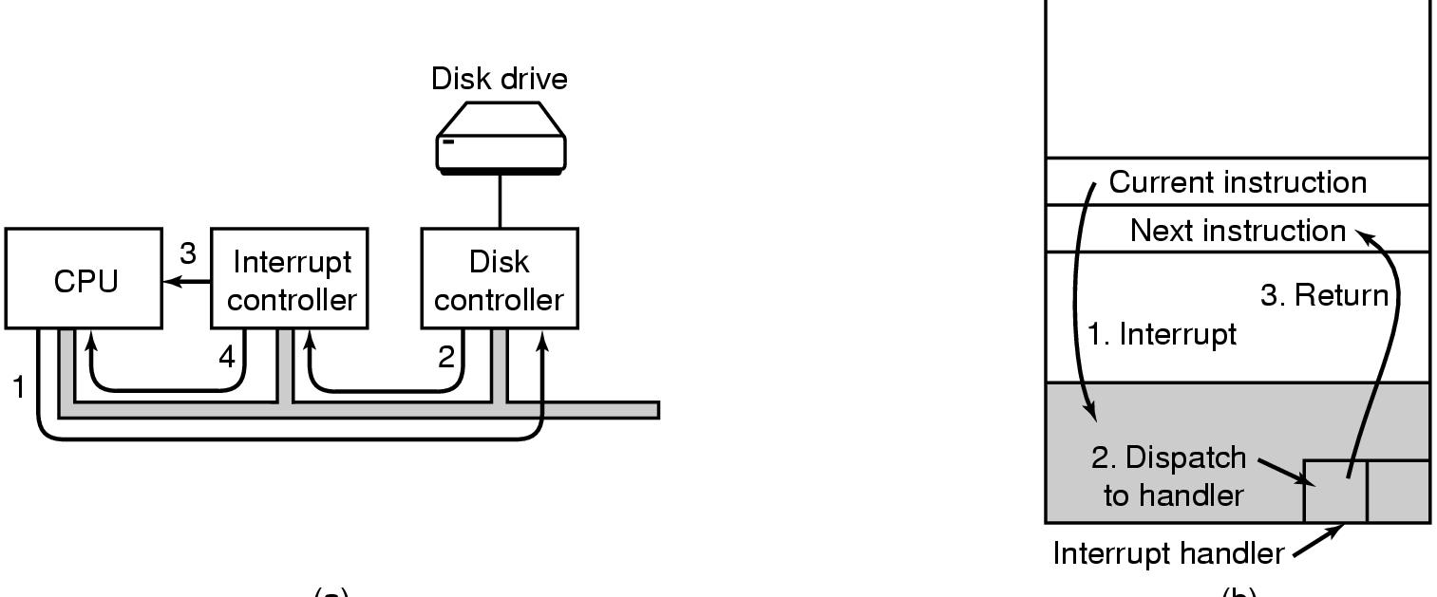
I/O Communication Techniques
(a)
(b)
(a) 启动I/O设备并引发中断的步骤
(b) CPU 是如何完成中断处理的
33

Slide 34
Tape is Dead Disk is Tape Flash is Disk RAM Locality is King
Jim Gray
Microsoft
December 2006

Slide 35
Computer Hardware Review
Processors: Architecture and Modes
Memory: Hierarchy of storage systems
I/O Devices: Clock, keyboard, monitor and hard disk
Buses: Organization of computer system
Operating System
35
CITS, NanKai University

Slide 36
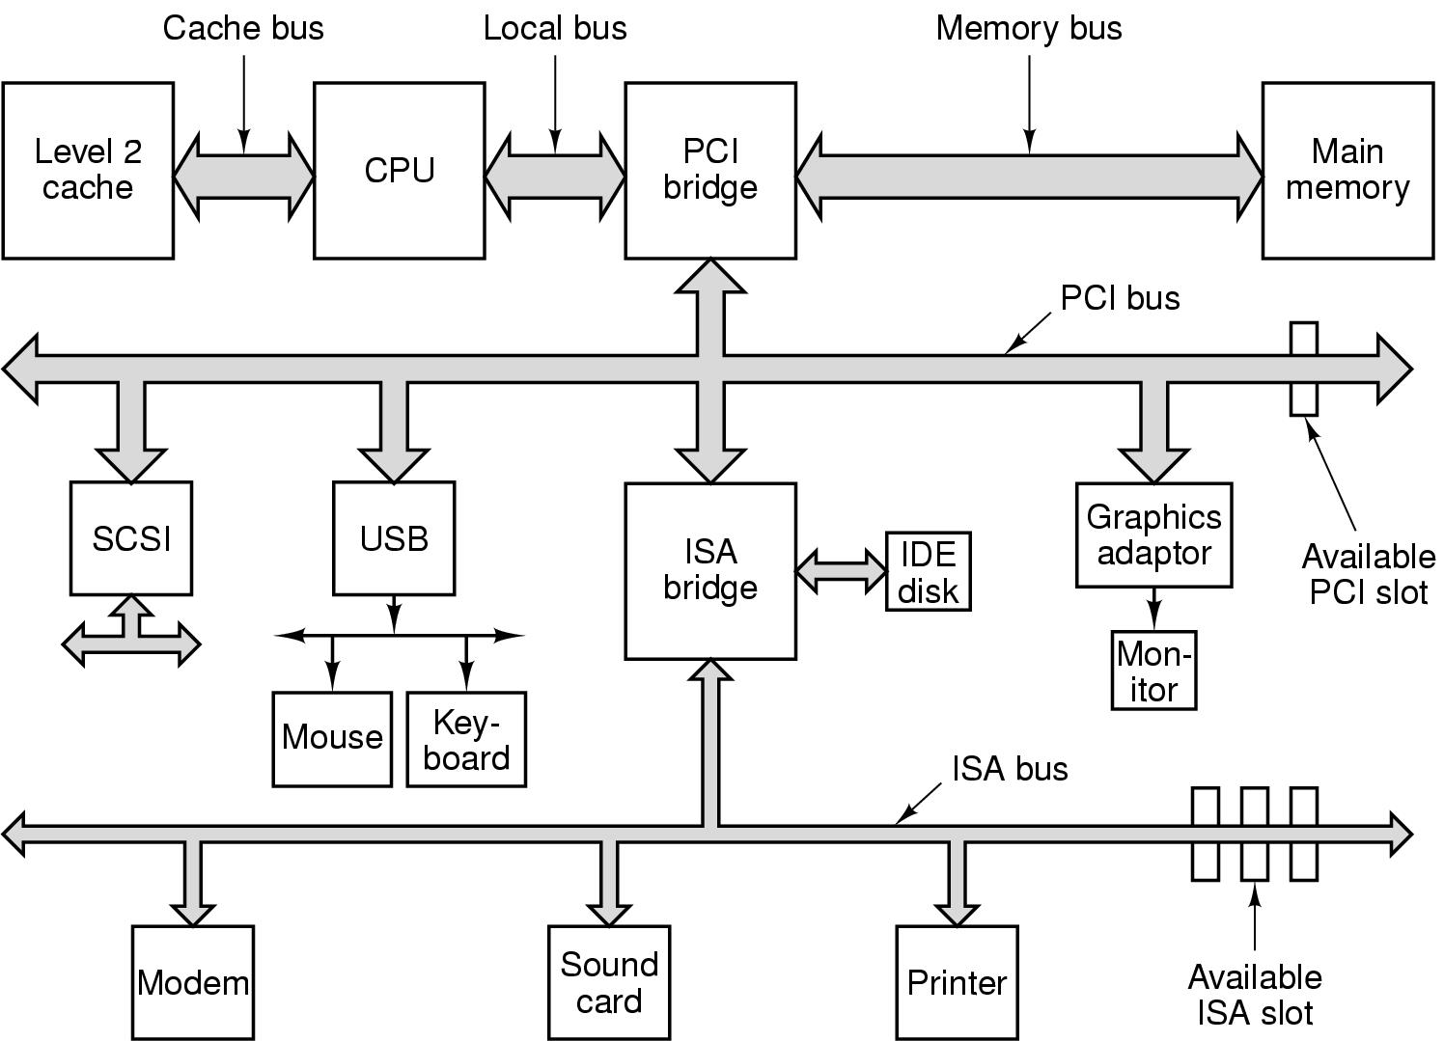
Architecture of Computer
Operating System
36
CITS, NanKai University

Slide 37
North bridge and south bridge
North bridge
Transfer data between CPU and memory/AGP
More expensive, faster and complicated
South bridge
Transfer data between I/O buses and devices
Cheap, slow and cheap
The communication between I/O and CPU
CPU don’t access I/O device directly
Some special mechanisms are designed for the link between north bridge and south bridge (DMA, I/O channel)
Intel Hub Architecture, SIS Multithread(妙渠)
Operating System
37
CITS, NanKai University

Slide 38
你需要记住的硬件细节
CPU是没有状态的，寄存器和内存代表了CPU的状态
高速存储永远都不够用，所以只能用局部性原理“欺骗”程序员
指令是不可以被打断的，中断只在指令之后处理，异常会在指令之前处理

Slide 39
Thanks for your time! Questions & Answers

